Slide 1
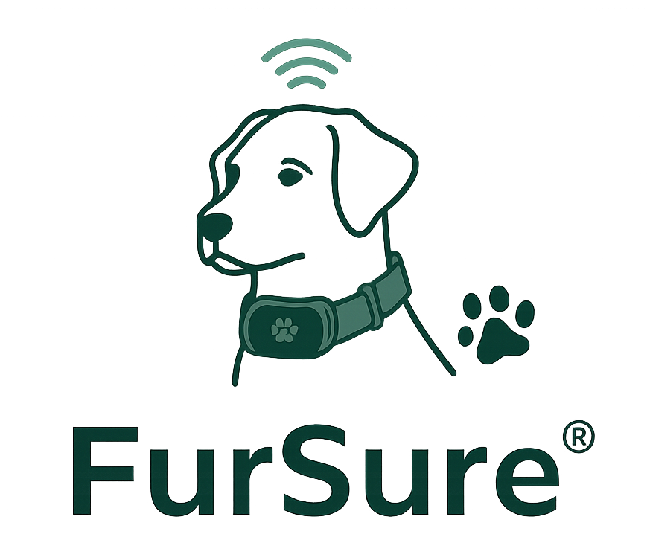
Don’t guess when it comes to your dog’s health, be FurSure.
Keegan Chatham, Matt Polin, Cameron Miller, Abby Hanvey, and Frankie Patton

Slide 2
Table of Contents
12 - Product Development Plan
3 - Executive Summary
13, 14 - Operations Plan
4 - Company Overview
15 - Risks
5 - Product
16, 17, 18- Financial Plan
6 - Market & Industry
19 - Funding Plan
7, 8, 9, 10 - Marketing Plan
20 - Research Citations
11 - Sales Plan
21 - Appendix

Slide 3
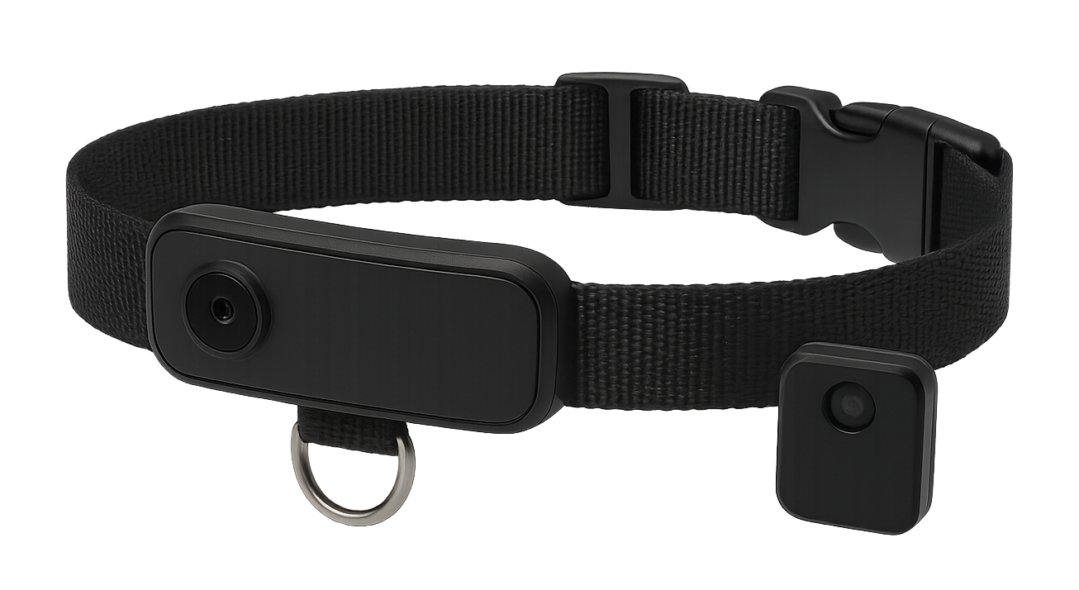
Executive Summary
FurSure is a pet wellness company that allows caring pet owners to take charge in their pets life. Our smart collar tracks multiple health metrics such as activity levels, sleep, and vital signs. Additionally, there is an optional camera and GPS tracking features.
FurSure’s target market is affluent dog owners in Boulder, CO who live an active lifestyle and are tech savvy. FurSure’s competitive edge is the user friendly app that has seamless integration of data. The data collected is then analyzed by machine learning algorithms, providing health scores and alerts when red flags are detected. We also offer flexible pricing options and are able to track more metrics than our competitors.
The opportunity within the pet industry is immense, with a global market of 500 million homes in major cities with a cat or dog. Almost 90 million homes own a dog in the USA alone. The pet industry is expected to increase by $270 billion by 2037. Americans pay double on pet supplies compared to 2013 and that number is expected to increase. We expect to be profitable by year 2 following our investor heavy phase.

Slide 4
Our Promise
What We Offer
Our Approach
How We Differ
Company Overview
FurSure is a smart pet collar that helps caring owners stay ahead of their pet’s health. It tracks activity, sleep, and vital signs — with GPS and optional live video — to deliver personalized, preventative insights. With flexible pricing and an easy-to-use app, FurSure puts your pet’s well-being first.
FurSure will use a direct-to-consumer model to build trust and highlight our product’s long-term value. Backed by survey data, we’ll focus on a professional, vet-supported online presence that lets us control messaging and deliver a clear, trustworthy customer experience.
Our product stands out with a user-friendly app interface, seamless integration of data collected from the collar, flexible pricing options, a robust number of metrics tracked, and an optional camera add-on for enhanced functionality.
FurSure is a pet wellness company that seamlessly integrates technology and pet care. It collects valuable data to provide insights for preventative care, fostering deeper bonds and reducing long-term veterinary costs.

Slide 5
Built to withstand active lifestyles and all-weather conditions, ensuring long-lasting use. (Complies with IP66 and IP68 standards)
Allows pet owners personalize the look, making it both functional and stylish.
Real-time location monitoring ensures owners can easily locate their pet as needed for added security.
Continuous data collection ensures early detection of health issues with machine learning algorithms, giving owners peace of mind.
Allows pet owners to effortlessly track and analyze their pet's health data in real-time, providing actionable insights and peace of mind right at their fingertips.
Our Product
Smarter Design, Smarter Care
Durable design
Personalization
GPS Tracking
24/7 Monitoring
Connected app

Slide 6
Over 500 million households in major markets (US, EU, and China) own a cat or dog. Pet supplies industry totals $8 billion.
TAM
All dog/cat owners
In the current pet market, 89.9 million US households own pets, with 68 million households owning a dog and 49 million owning a cat.
SAM
All dog/cat owners living in the United States
Market Capture
Of the 2.3 million Colorado households, 47% own a dog and 27% own a cat.
SOM
All middle/upper-class dog and cat owners living in Colorado
Caring, tech-savvy upper-class dog owners, aged 25-44, living in Boulder, Colorado, who lead active lifestyles with their dog.
Beachhead

Slide 7
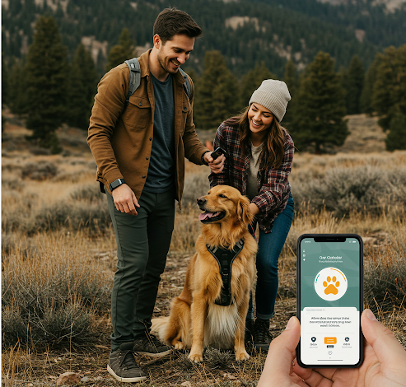
Our Target Customer
Demographics
Psychographics
Dog owners who make $100,000 annually
Aged 24-44
Residing in Boulder, Colorado
Active outdoor lifestyles
Tech savvy
Deeply committed dog owners who view pets as family
Emotionally and financially invested in their pets’ well-being
Motivated by products that extend and enhance their dogs’ lives

Slide 8
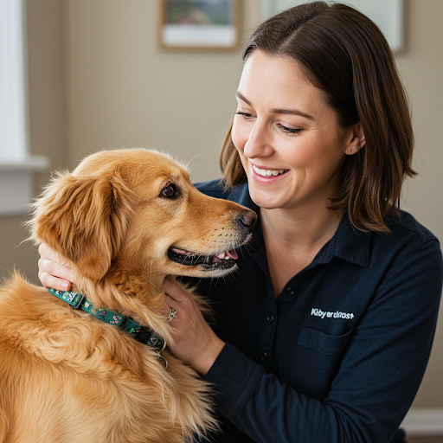
Meet Danielle
32-year-old, financially stable
Views her dog, Teddy, as her best friend and emotional support
Experiences anxiety about losing him, driving a strong interest in longevity solutions
Seeks trustworthy, science-backed products to support Teddy’s health
Values convenience, clear communication, and low-risk trial options

Slide 9
Our Pricing Flexibility
FurSure Collar
FurSure Plus
FurSure Guardian
Perfect for active pet owners
Tracks steps, distance, and daily activity to monitor your pet’s lifestyle. See how your pet is living their best life in our app, which offers personalized insights and tips
Take your pet care to the next level with stress tracking. We'll monitor respiratory rate and sleep patterns, giving you a more comprehensive view of their emotional and physical well-being.
Understand how your dog is truly feeling and ensure their happiness.
Our premium plan with real-time tracking, proximity alerts, advanced health tracking, and access to an added camera attachment for live video 24/7—includes all features from lower tiers
$175 (one time purchase)
$10 / month
(plus cost of collar)
$18 / month
(plus cost of collar)

Slide 10
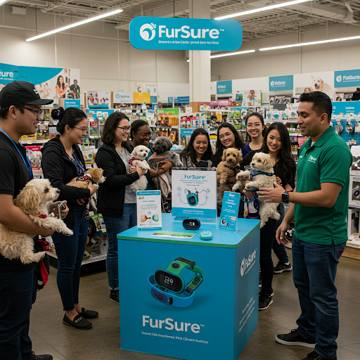
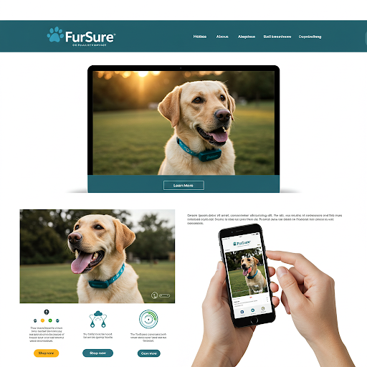
1) Pet Store Pop-Ups
2) Online Website
Reaching Our Customer
Our pet store pop-ups will feature product demos to capture interest with appealing displays and offers. We'll drive expansion through referral incentives and upselling, and ensure retention by gathering feedback and utilizing email for updates.
We'll create an accessible website and build a social media presence with engaging pet health content and the dog park sticker campaign. We'll drive subscription upgrades with free trials and exclusive app features, and implement cart abandonment emails, customer reviews, and a 3-month money-back guarantee for retention.

Slide 11
The Sales Plan
Drive initial awareness and interest in Boulder via QR code stickers on dog trails, engaging social media with influencers (generating ~50% organic leads), and interactive demos at pet events, targeting a $10 cost per lead.
Awareness & Interest
1
Offer coupons at local vets, actively encourage and showcase positive customer reviews, and provide risk-free testing through easy returns.
Appraisal & Desire
2
Leverage influencer partnerships with compelling discount offers.
Action & Confirmation
3
Maximize conversion by clearly communicating the life-enhancing benefits for pets, reinforcing trust through veterinary endorsements and positive customer feedback, and recovering lost sales with cart abandonment reminders.
Conversion
4

Slide 12
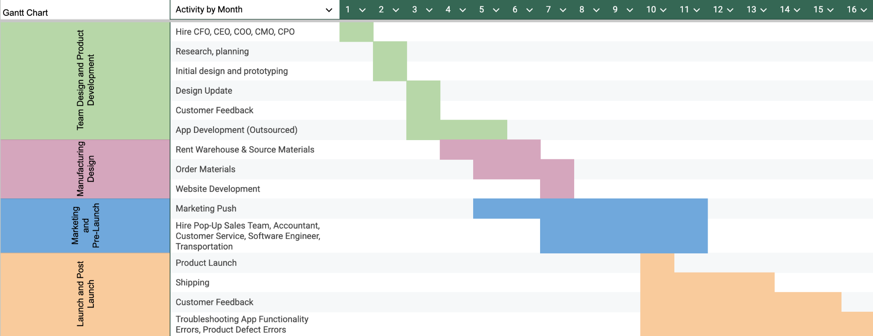
Product Development Plan
Customer Feedback Integration: Used in design, app, and launch
Early Research & Hiring (Months 1-6): Informs design & app
Manufacturing Prep (Months 6-8): Based on final designs
Milestones
Parallel Development: Website & marketing run
Month 10 Launch: Product goes live
Post-Launch: Shipping, customer feedback, app & product troubleshooting for long-term success

Slide 13
Operations Plan
$40k annually
3 Full Time Customer Service Agents & Software Engineer
$1.7k
Camera Footage
$36k
First Year Payroll Taxes
$22.5k
App Maintenance
$10k
Insurance
$84
Data Storage
$2k
Collar GPS Connectivity
$20k
Firmware Updates
$3.6k
CRM Tools
$3k
Influencer Marketing
$2.4k
Vet Partnerships
$500
Sticker Campaign

Slide 14

Meet the Team
Excels academically in finance, experienced in student budget management, analytical.
CFO Cameron
Student leader with strong communication and a passion for the FurSure mission. Background in statistics and data science.
Social media savvy with creative marketing experience in student contexts. Without Matt, marketing wouldn't exist today.
CMO Matt
CEO Keegan
Highly organized with project coordination skills from academic and extracurricular activities.
COO Frankie
CPO Abby
Strong understanding of our product area, skilled at identifying user needs and envisioning solutions.
Notes:
Theme color #093607

Slide 15
Risks and Our Mitigation Strategies
Risk Type | Description | Risk Level | How to Mitigate
Financial | Not enough subscriptions | High risk | Effectively communicate the benefits of subscribing to higher tiers
Operational | Design and implementation of hardware | Moderate risk | Embed AI in hardware to predict and proactively address potential failures before they occur
Regulatory | Health and wellness claims | Low risk | Clear disclaimers that we do not diagnose, but only help to provide data for potential health issues

Slide 16
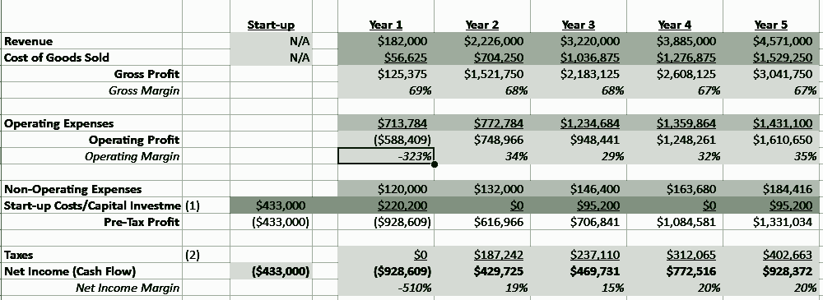
Net Income Statement
5 year revenue forecast projects profitability by Year 2, following initial investment-heavy launch phase
Year 1 reflects expected startup losses, these are fully covered by our lead angel investor. Steady growth driven by targeted marketing efforts, accelerating subscription adoption and brand awareness
As customer base expands, operating expenses rise starting Year 3, primarily due to strategic hiring and increased sales volume
Capital expenditures grow in tandem with scale, reflecting planned investments in technology, equipment, and logistics infrastructure supporting long-term growth and operational efficiency

Slide 17
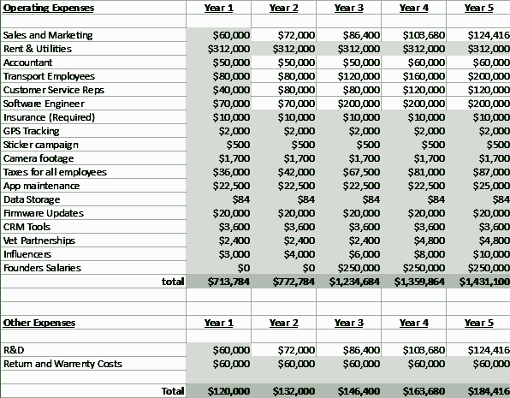
Operating Expenses
Primary OPEX:
Employees, sales, marketing, and other key data driven insights support the collar’s functionality
How OPEX will change:
Our operating expenses are expected to double by year five as the company grows and more resources are needed.
Influencers:
Influencer partnerships - an expense that we expect to grow exponentially as do
We believe that long term partnerships will help to take FurSure to new heights

Slide 18
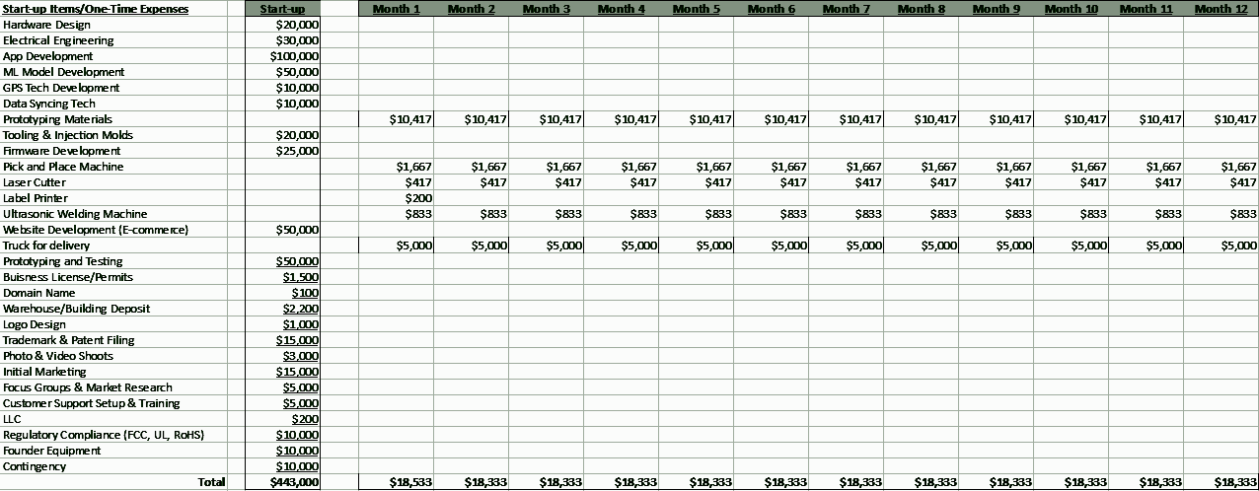
Start Up/One Time Expenses
Primary Startup Costs:
Initial app and collar development (including connectivity), as well as licensing and testing
Costs to establish business (LLC, licenses, etc.)
Primary CAPX:
Machines for production, trucks for delivery
Expect to grow/scale machinery
Anticipate adding more to the fleet as we capture market share

Slide 19
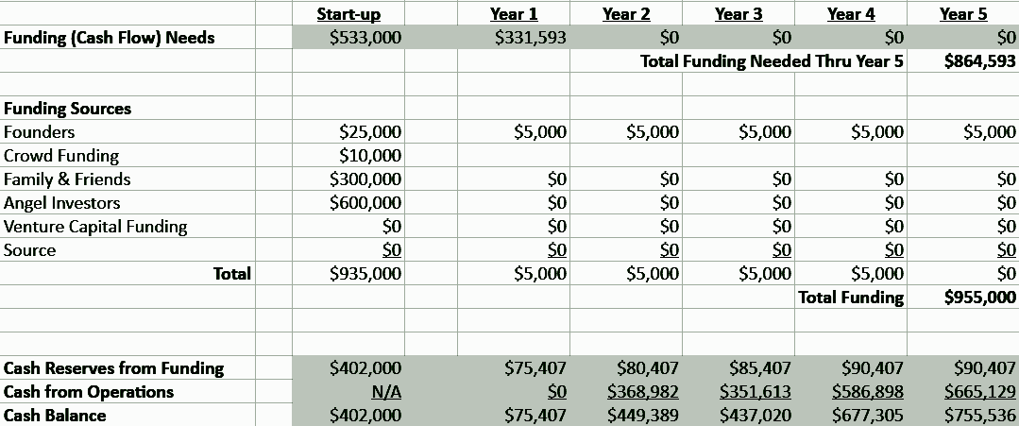
Funding Plan
$865,000 in funding through its first 5 years of operation
The founding team will each contribute $1,000 per year for the first 5 years, totaling $5,000
$10,000 from crowdfunding (GoFundMe)
$300,000 from family contributions
$550,000 from angel investors
Anticipate offering an equity stake of 10-15%, subject to negotiation.

Slide 20
Research Citations
Animals, H. (2024, March 27). HealthforAnimalsGlobal trends in the pet population |. HealthforAnimals. https://healthforanimals.org/reports/pet-care-report/global-trends-in-the-pet-population/#:~:text=Trends%20in%20pet%20ownership%20are,income%20and%20level%20of%20education.
Boulder, CO Household Income, Population & Demographics. (n.d.). https://www.point2homes.com/US/Neighborhood/CO/Boulder-Demographics.html
Compare and Buy Pet Insurance Today. Pawlicy Advisor. (n.d.). https://www.pawlicy.com/
“FI Releases Its GPS-Integrated ‘airtag for Dogs’ - Introducing the FI Series 3.” Business Wire, 17 Oct. 2022, www.businesswire.com/news/home/20221012005220/en/Fi-Releases-its-GPS-integrated-%E2%80%98AirTag-for-Dogs%E2%80%99-%E2%80%94-Introducing-the-Fi-Series-3#:~:text=Headquartered%20in%20New%20York%2C%20Fi,families%20across%20all%2050%20states.
Global Animal Health Association. (n.d.). https://healthforanimals.org/
Intelligence, M. (2024, November 4). United States Pet Market Size: Mordor Intelligence. US Pet Industry - Trends & Growth Projections. https://www.mordorintelligence.com/industry-reports/united-states-pet-market
Leading Pet Industry Association: American Pet Products Association. Leading Pet Industry Association | American Pet Products Association. (n.d.). https://americanpetproducts.org/
Lenoir, W. (2024, December 2). Pet industry trends that impact what consumers buy. Cutting Edge Products. https://cuttingedgeproducts.org/spotlight-on-business/pet-industry-trends-that-impact-what-consumers-buy/
“PETPACE Information.” Rocketreach.Co, rocketreach.co/petpace-profile_b55e162af9ec7913#:~:text=What%20is%20the%20annual%20revenue,was%20%245.1%20million%20in%202025. Accessed 13 Feb. 2025.

Slide 21
Appendix
Slide 5- IP66 and IP68 are Ingress Protection (IP) ratings that indicate a device's protection against dust and water. IP66 provides dust-tight protection and resistance to strong water jets, while IP68 offers the same dust protection and the ability to withstand continuous submersion in water under specified conditions.
Survey
https://docs.google.com/spreadsheets/d/1zKRX0gPBzKVLvPCctIfEAYOTedHGCCqD1uwrWBYxTQs/edit?gid=1351454656#gid=1351454656
Financials
https://docs.google.com/spreadsheets/d/1BT7Vgs_jBEHoCJH5dmcov92KtpedYb7rzE8FN0EMSeE/edit?gid=593354892#gid=593354892
Timeline Gantt Chart
https://docs.google.com/spreadsheets/d/1jLoz7U2ROqb51pbMlvmbsiszo3xwBYPY22UpmcDG_AM/edit?gid=0#gid=0

